Slide 1
Hackathon Agenda
Group 19

Slide 2
Updated Google Docs
A new ML model and additional data source is description in the modelling section.
Doc URL: https://docs.google.com/document/d/1p8l5hhI2smvjlkJi7AtNk8piePNGp5bwDnsZBWfQPDk/edit#

Slide 3
Long Term Goals:
Frontend: A nicely structured user interface letting the user get information about their friends' mood swing efficiently. With the tweet map, content page and mood chart built in, the user can get not only the mood swing but also the underlying tweet content and the basic idea of the friend's recent life. The frontend should be friendly to the users, while maintaining sophisticated function set.
Backend: A well designed and implemented backend system which supports the frontend system robustly. With the help of AWS lambda and micro services architecture, it scales well for large amount of requests, while evolving smoothly. The backend system collects the required data in real time, performing analysis and feed the data to the frontend.
Modeling: A carefully chosen feature set is the key to the success of such system. We will perform the machine learning technologies to the data we retrieved from different sources. With performance in mind, we construct a relatively small yet powerful model for the analysis. It will generate friends' sentiment from the raw data and finally become the happy or sad faces displayed on the user's screen.

Slide 4
Added Functionalities
Gather user behaviors (e.g. number of phone calls and frequent location) from mobiles, create baseline and send out alert for unusual behavior
This is intended for use case like “elderly care”

Slide 5
Hackathon Goal:
Discuss project idea and architecture with TAs and the Professor (done)
Brainstorm additional functionalities and data source (recommendation feature, mobile centric data)
Go over architecture plan (done)
Start coding (yes)

Slide 6
Achievement in Hackathon
ML data acquisition:
1.1 Sampling tweeter users from Manhattan
1.2 Wrote script for gathering historical data by user-ids using Twython
2. Frontend：Went through the design stages, proposed a fully functional set of user interface prototypes.
3. Backend ：Designed the basic architecture of the backend system.

Slide 7
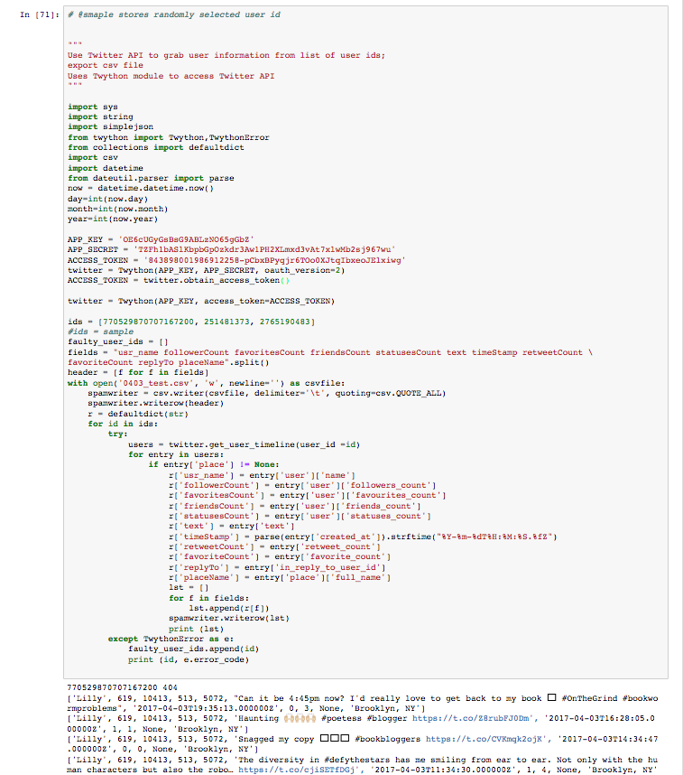
Hackathon Achievements - screenshots
ML data acquisition:
1.1 Sampling tweeter users from Manhattan
1.2 Wrote script for gathering historical data by user-ids using Twython

Slide 8
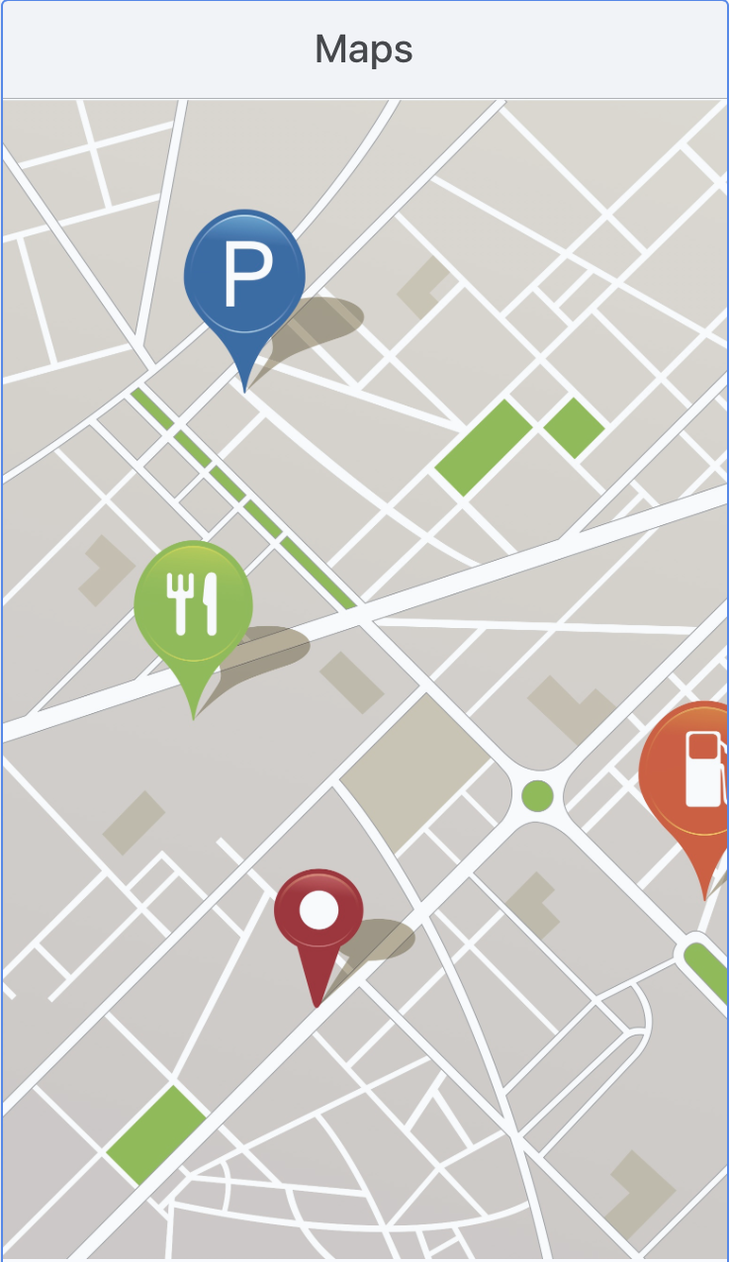
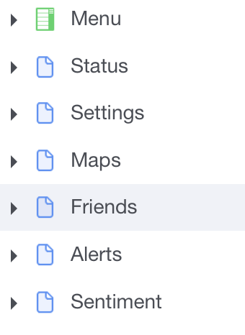
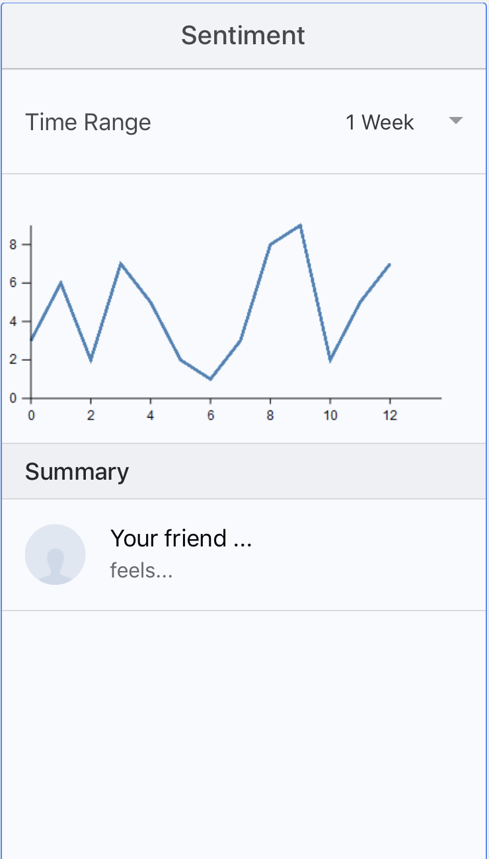
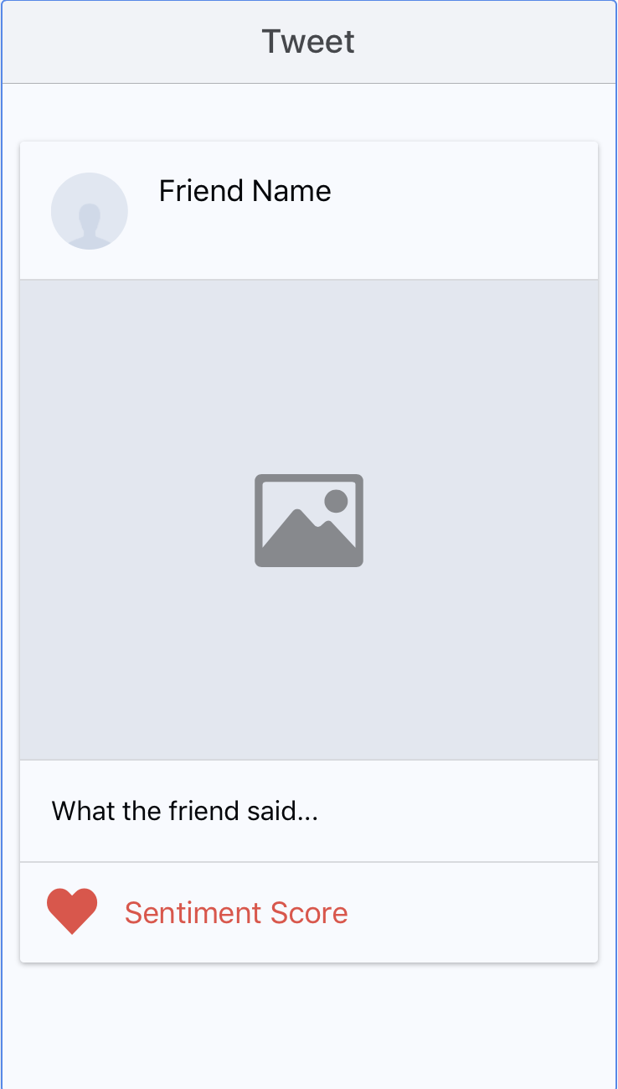
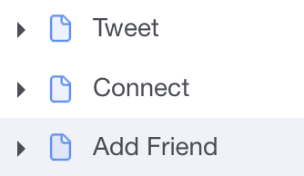
Hackathon Achievements - screenshots
Frontend：Went through the design stages, proposed a fully functional set of user interface prototypes.

Slide 9
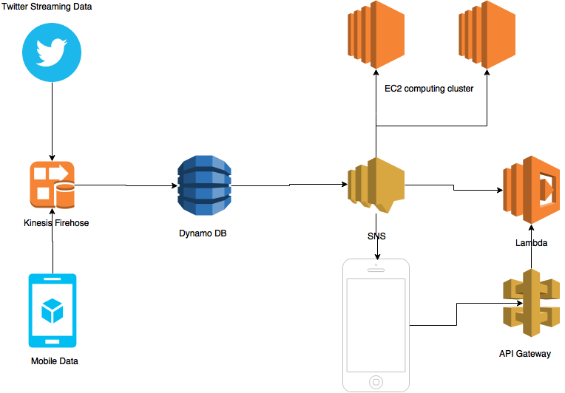
Architecture Diagram
Notes:
这图6

Slide 10
Steps for the rest of the semester
Frontend (Angular2 with Ionic)
Backend on EC2 (or Lambda)
Gather historical data from mobile phones, gather historical tweets
Refine the clustering of user profiles: build ML model for Alert

